Slide 1
IBM University Engagement Project Submission
“Exploring the Power of Machine Learning with IBM Cloud”

Slide 2

Project Tile – [AI Interview Trainer Agent using IBM watsonx.ai ]
Domain of Project – [ Education / Artificial Intelligence]
Student Name | Recent Passport Photo | Email ID | Mobile number [WhatsApp]
Gaddam Manogna Reddy |  | maanognaredy@gmail.com | 7981914551

Slide 3
Problem Statement -
Problem Statement: Predicting Eligibility NSAP for using Machine Learning
Preparing for technical interviews is challenging because candidates often lack personalized practice, role-specific interview questions, and constructive feedback.
The objective of this project is to develop an AI-powered Interview Trainer Agent that generates technical and HR interview questions, evaluates candidate responses, and provides personalized recommendations based on the candidate's job role, experience level, and uploaded resume.
The solution uses IBM watsonx.ai with IBM Granite Foundation Models to deliver an intelligent interview preparation experience.

Slide 4
Proposed Solution -
We propose an AI-powered Interview Trainer Agent using IBM watsonx.ai and the IBM Granite Foundation Model.
The user uploads their resume or enters their job role and experience level through the Streamlit web application.
The application extracts the resume information and securely sends the user details to IBM watsonx.ai using the IBM Cloud API.
The IBM Granite Foundation Model analyzes the candidate's profile and generates role-specific technical interview questions, HR interview questions, model answers, and interview preparation tips.
The system also evaluates the candidate's responses and provides personalized feedback and recommendations to improve interview performance and confidence.
This AI-powered solution helps students and job seekers prepare effectively for interviews through personalized guidance, making the interview preparation process more interactive, efficient, and accessible.

Slide 5
Technology Used
IBM Cloud
IBM Cloud provides the infrastructure to build, deploy, and integrate the AI Interview Trainer Agent efficiently. It enables secure access to IBM watsonx.ai and the IBM Granite Foundation Model through API integration, ensuring reliable, scalable, and AI-powered interview question generation and evaluation.
ML Algorithm / Model Used
IBM Granite 4 H Small Foundation Model (Large Language Model - LLM)
Accuracy Obtained
Generated relevant and role-specific interview questions with high-quality AI responses based on the candidate's job role and experience level.
(Since this is an LLM application, a traditional accuracy percentage is not applicable.)
Enhancements and Hyperparameter Tuning
Prompt Engineering for role-specific interview generation.
Experience-level based question generation.
Temperature = 0.5 for balanced AI responses.
Max New Tokens = 300 for detailed outputs.
Resume-based and job role-based personalized interview preparation.

Slide 6
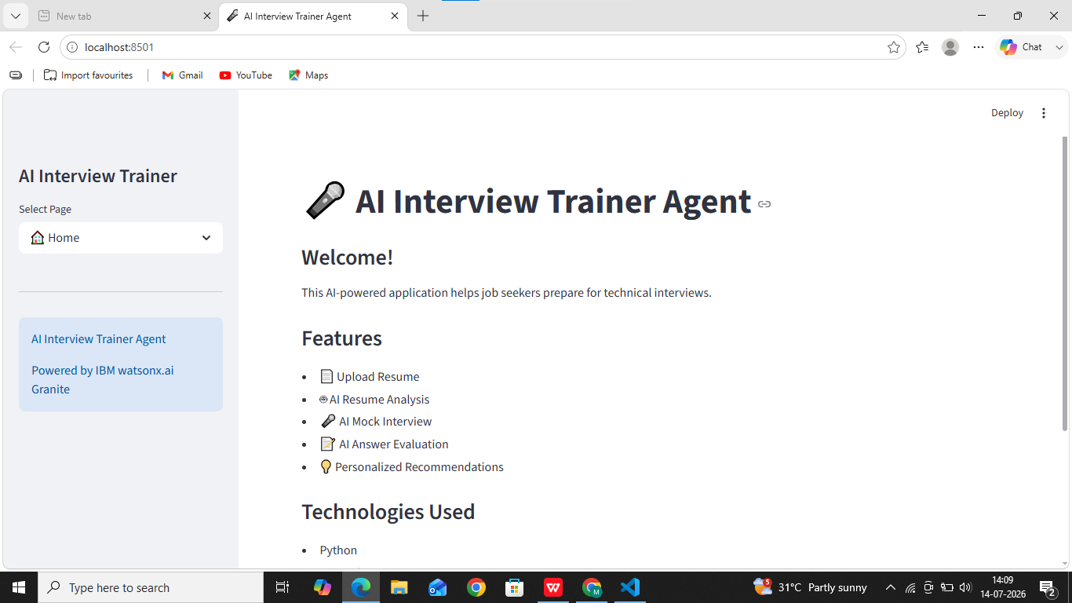
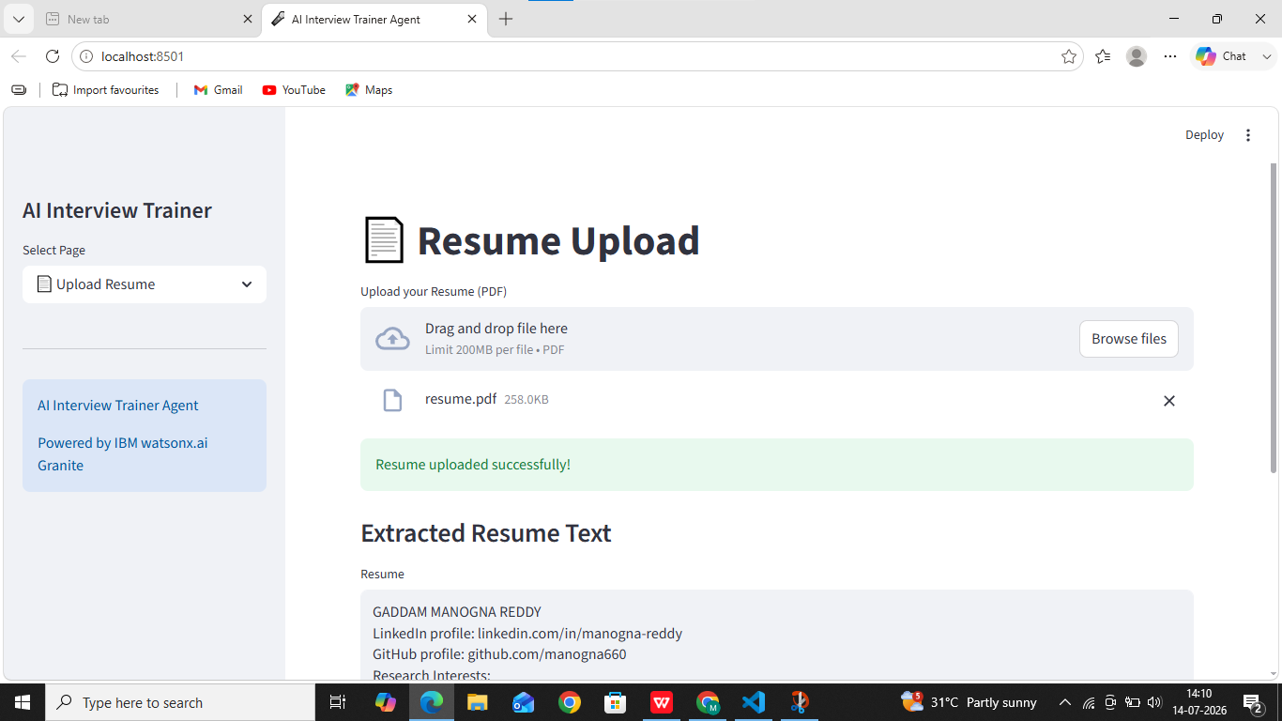

Slide 7
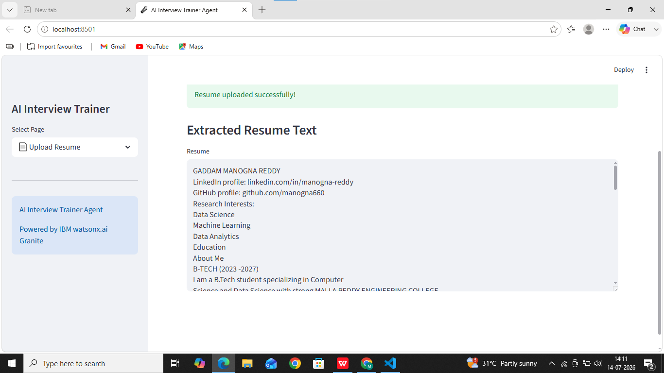
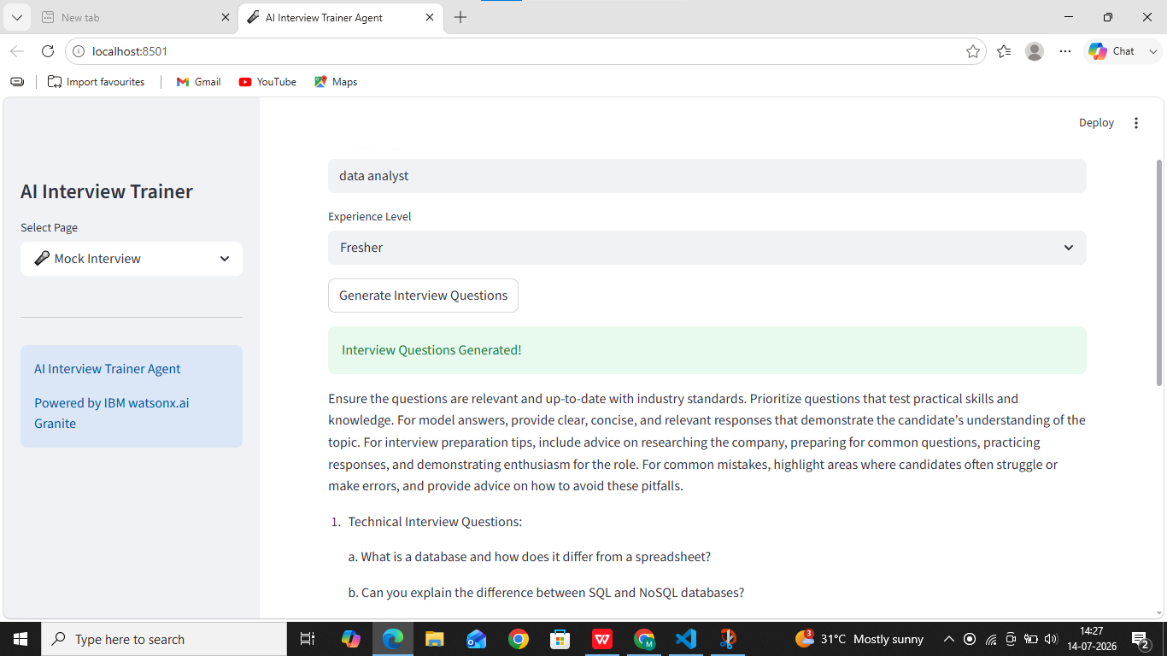

Slide 8
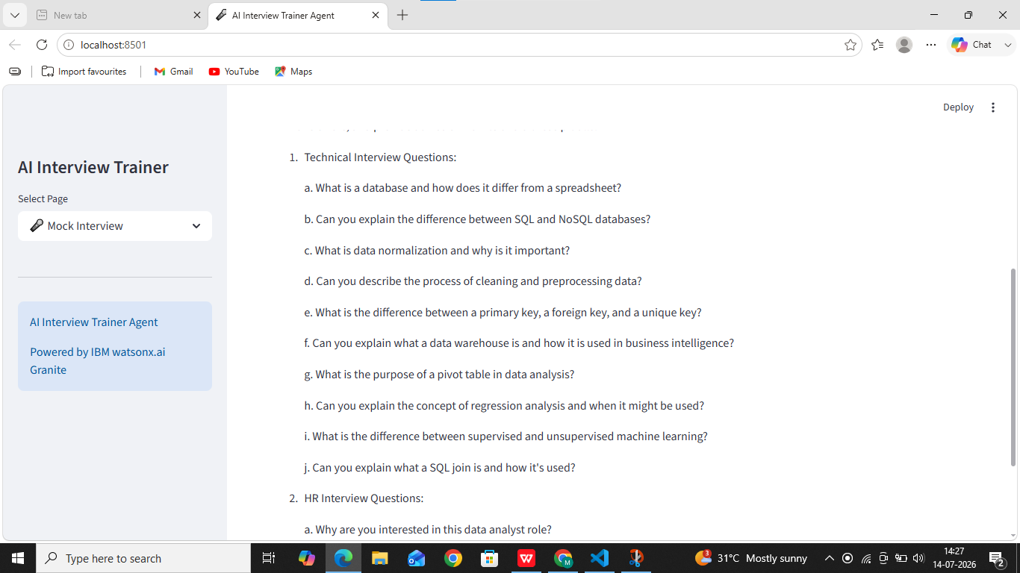
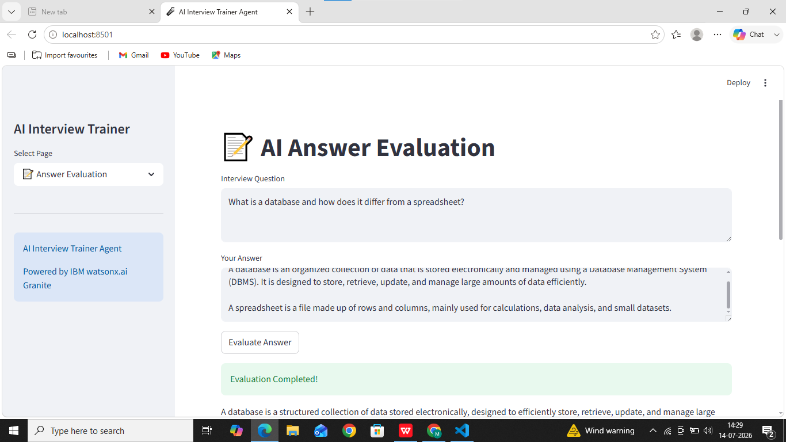

Slide 9
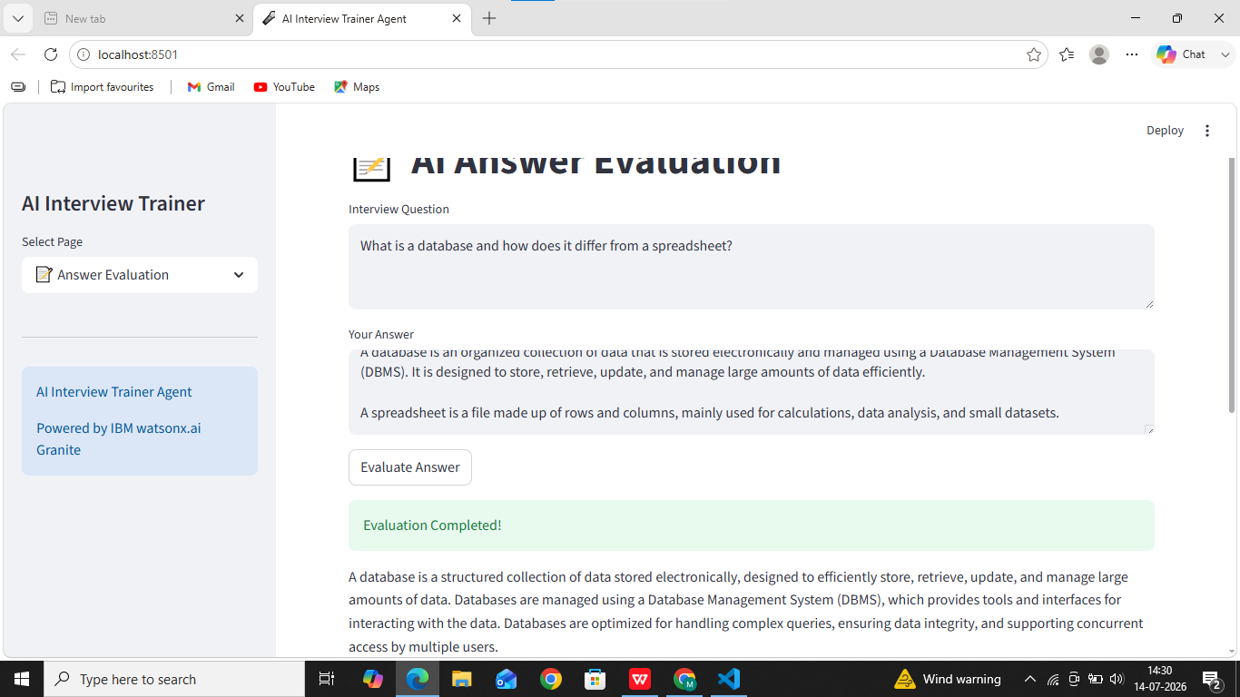
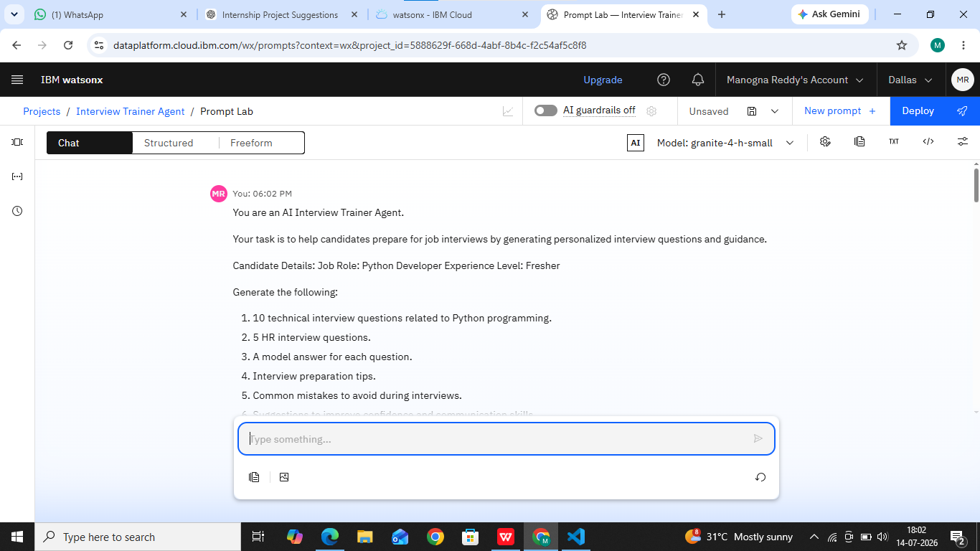

Slide 10
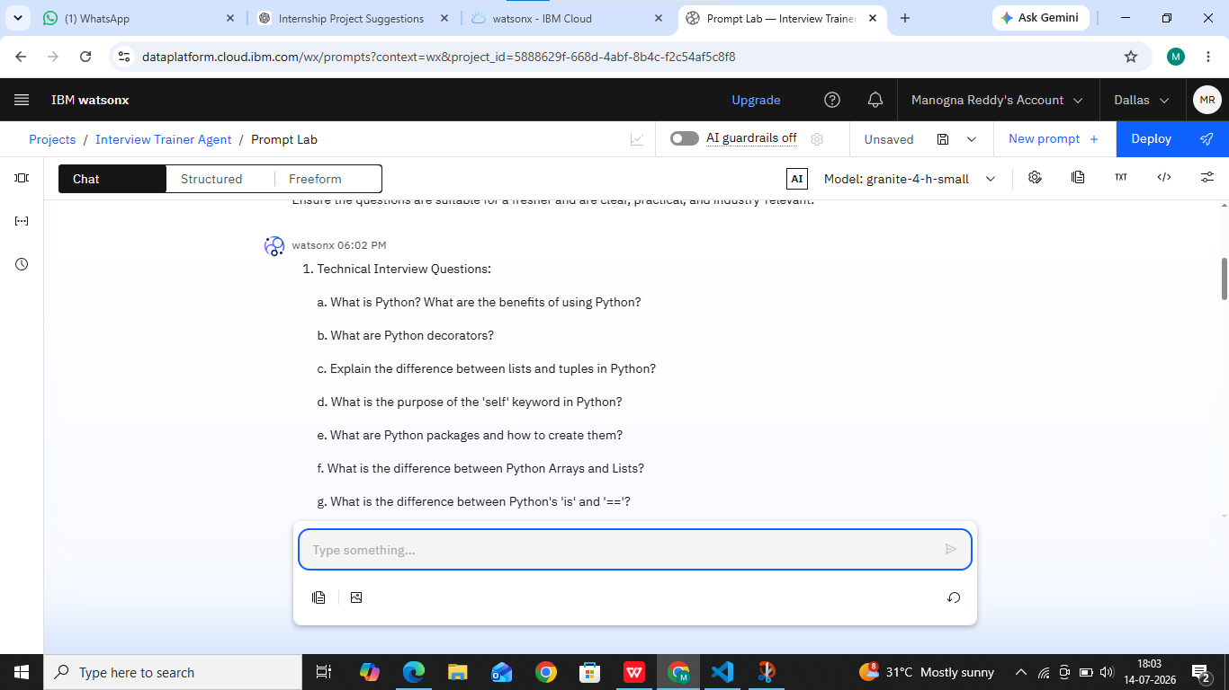
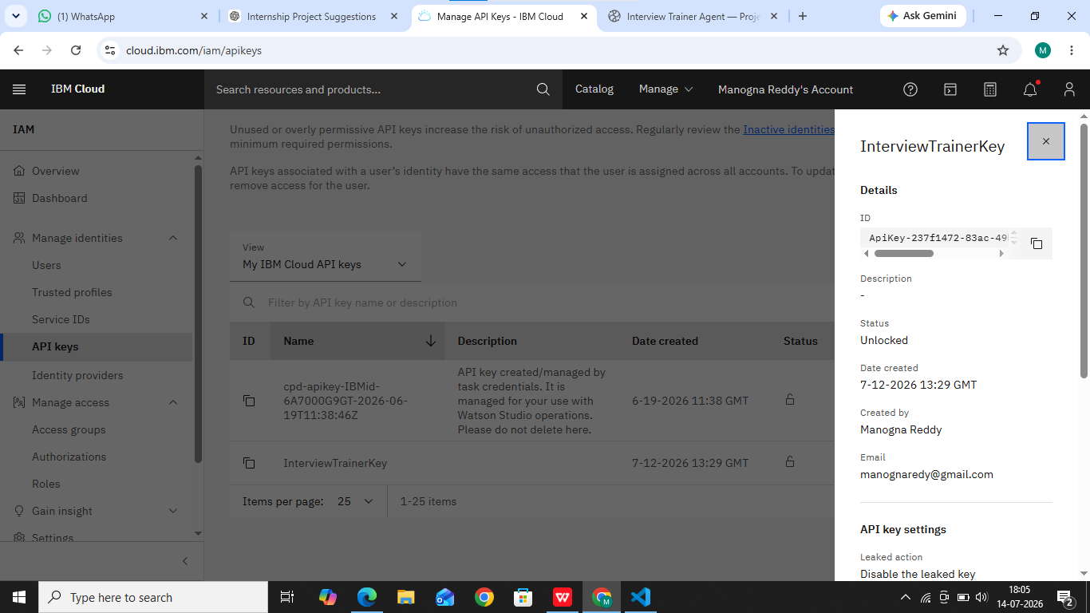

Slide 11
Novelty and Uniqueness
The solution automates interview preparation by generating personalized technical and HR interview questions based on the candidate's job role and experience level.
It uses IBM watsonx.ai with the IBM Granite Foundation Model to generate intelligent interview questions, model answers, and preparation tips without requiring manual question creation.
The system provides AI-powered answer evaluation and personalized recommendations, helping candidates identify their strengths and areas for improvement.
The application combines resume analysis, interview question generation, answer evaluation, and career guidance into a single user-friendly platform.
Personalized prompt engineering enables the AI to generate role-specific and experience-based interview content, making interview preparation more effective and relevant.
The web-based interface makes the solution easy to access, scalable, and beneficial for students, fresh graduates, and job seekers preparing for competitive interviews.

Slide 12
Git Hub Link
Please create public github repository (Enable Add README button while creating repository) with format –
Please test and Paste the working Github URL –
Make sure you have Uploaded following three files into your github repository 1) Data.csv file, 2) yourproblemstatement.pdf file 3) your project presntation.pptx file 4) Python Notebook downloaded from IBM Cloud
·
·
·

Slide 13
Future Scope
Resume-based RAG Integration to generate highly personalized interview questions based on the candidate's resume and skills.
Voice and Video Mock Interviews with speech recognition and confidence analysis for a real interview experience.
Company-Specific Interview Preparation by generating questions based on company job descriptions and interview patterns.
AI Performance Dashboard to track interview scores, progress, strengths, weaknesses, and improvement over time.
Deployment on IBM Cloud for secure, scalable, and real-time access from anywhere.
Multilingual Support to help candidates prepare for interviews in multiple regional and international languages.
AI Career Guidance by recommending courses, certifications, and skill improvements based on interview performance.
·
·
·

Slide 14
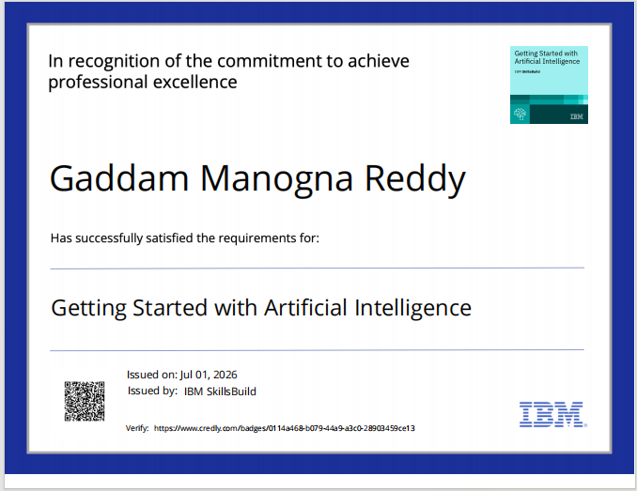
Certificates Earned:

Slide 15
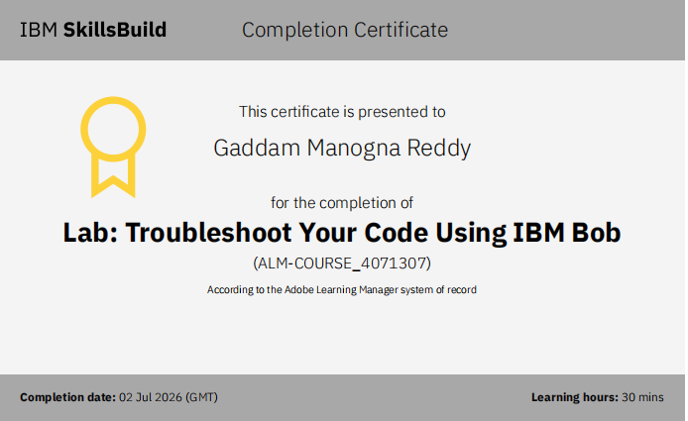
Certificates Earned:​

Slide 16
Thank You!

